Slide 1
Supply Chain Delay Analysis
Power BI Dashboard Presentation

Slide 2
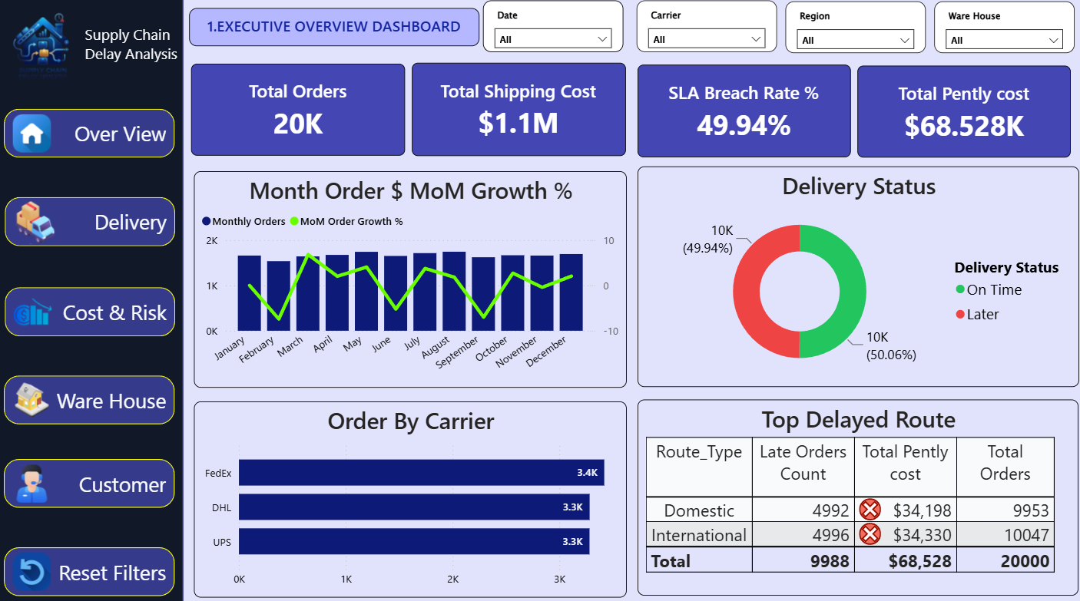
Executive Overview Dashboard
Presentation Script:
This dashboard provides a high-level overview of supply chain performance.
The company handled 20K total orders with $1.1M shipping cost.
SLA breach rate is around 49.94%, which indicates delivery delays.
International routes have slightly more delayed orders than domestic routes.
FedEx handled the highest number of orders among all carriers.

Slide 3
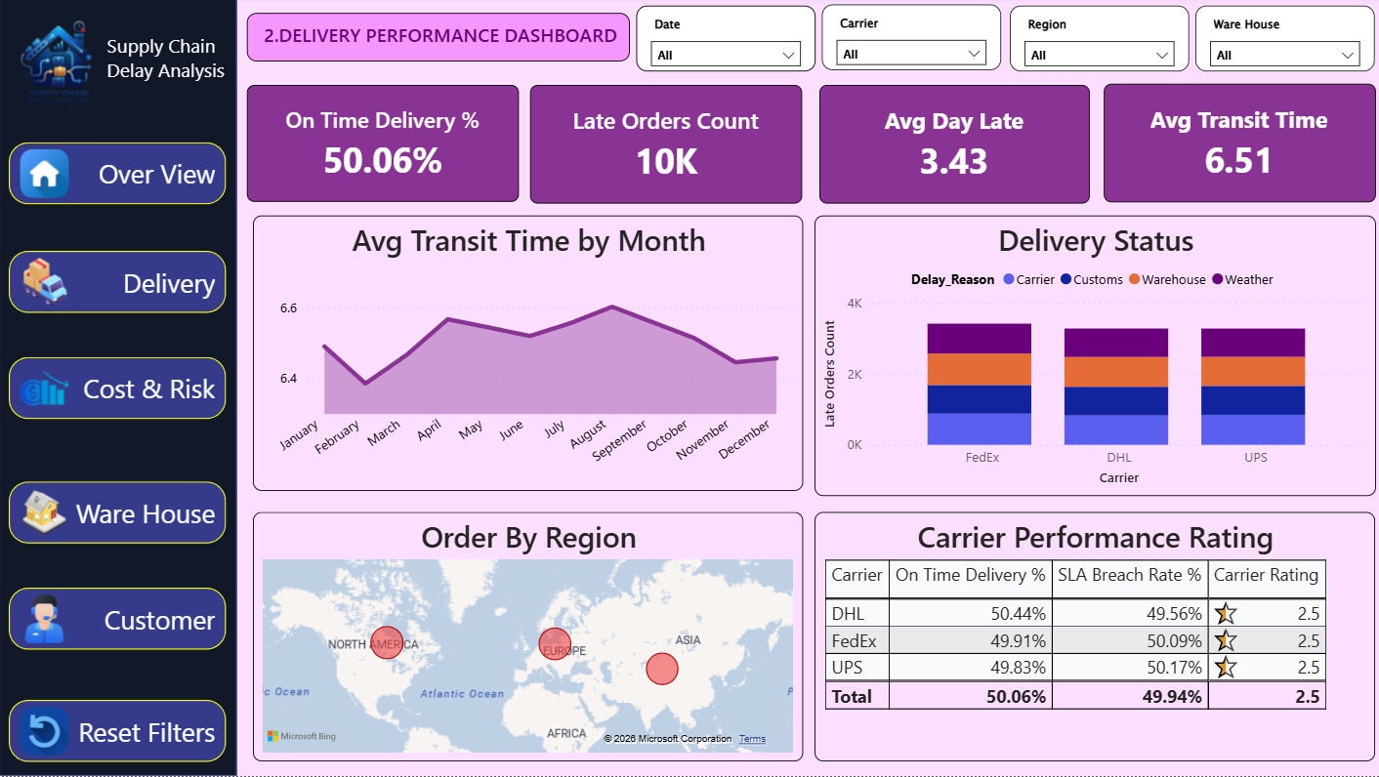
Delivery Performance Dashboard
Presentation Script:
This dashboard focuses on delivery efficiency and transit performance.
On-time delivery percentage is 50.06%.
Average delay is 3.43 days and average transit time is 6.51 days.
Weather, customs, and warehouse issues contribute to delivery delays.
All carriers show similar SLA breach rates.

Slide 4
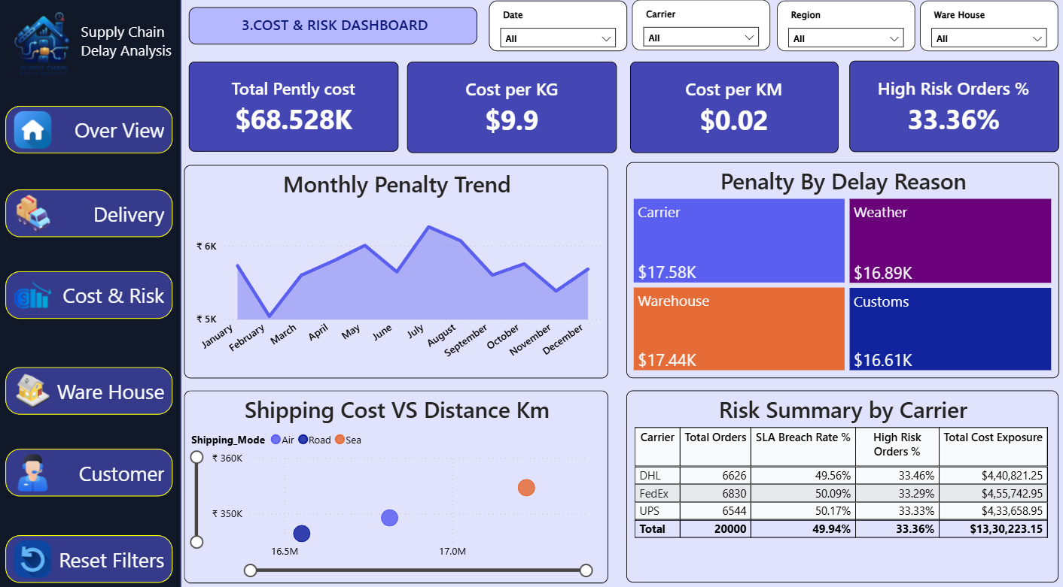
Cost and Risk Dashboard
Presentation Script:
This dashboard analyzes logistics cost and operational risks.
Total penalty cost is $68.5K due to delays and SLA breaches.
Weather-related delays generated the highest penalty cost.
Sea shipping has higher shipping cost compared to road and air transport.
High-risk orders percentage is 33.36%.

Slide 5
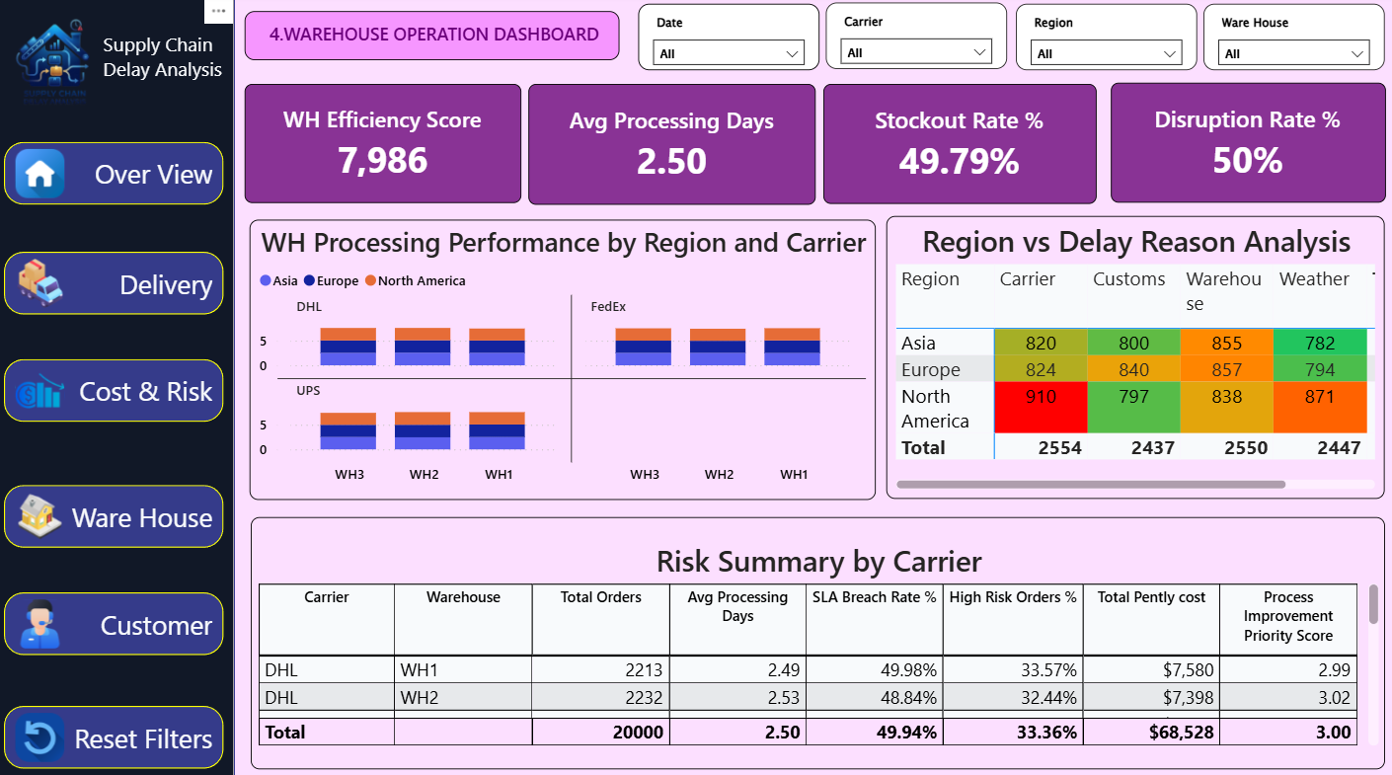
Warehouse Operation Dashboard
Presentation Script:
This dashboard tracks warehouse processing and operational efficiency.
Average processing time is 2.5 days.
Stockout and disruption rates are close to 50%.
North America has higher carrier-related delays.
Warehouse WH1 and WH2 show similar performance levels.

Slide 6
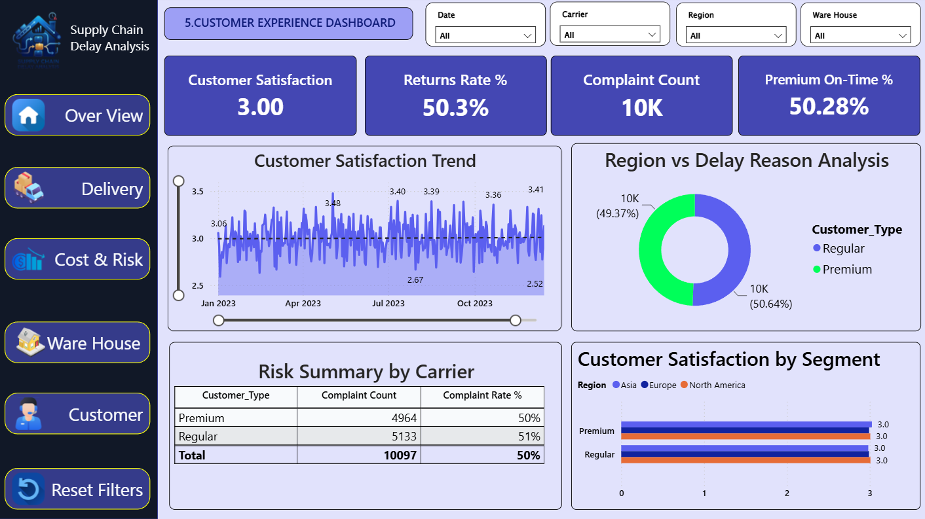
Customer Experience Dashboard
Presentation Script:
This dashboard focuses on customer satisfaction and complaints.
Customer satisfaction score is 3 out of 5.
Return rate is 50.3% and complaint count is around 10K.
Premium and regular customers show similar satisfaction levels.
Customer satisfaction remained stable throughout the year.

Slide 7
Conclusion
Key Takeaways:
Supply chain delays are mainly influenced by weather, warehouse, and customs issues.
SLA breach rate and delayed orders are close to 50%, indicating improvement opportunities.
Penalty costs can be reduced by improving warehouse efficiency and delivery planning.
Customer satisfaction can improve with faster delivery and better issue resolution.

